Slide 1
ECSC 325.200
Web Server Administration
Spring 2025 - Week 10-1 – March 28th, 2025
File Transfer Services and Stuff
Prof. Jason Patalon

Slide 2

Weekly Info
“No act of kindness, no matter how small, is ever wasted.” - Aesop
Attendance…
Stuxnet Virus Video?!
  https://www.youtube.com/watch?v=J07N1KXOyfk
    10 Minute runtime
Assignment 9 due this week
  Email setups
Good of the class
  Coronavirus
    Stay safe, wash your hands, don’t touch me, quit putting stuff in your mouth.
  Final Exam
    300 Points
    Tuesday April 29th, 2025
    5:00PM – 7:00PM

Slide 3

Recap and Review
The next few weeks…
  File transfer services
  Security and authentication
  Network Services
  Monitoring and performance tuning
  Cloud
Corrections, updates, etc.
  Email not coming through last week – I was on the wrong server…
    That server was forwarding the email to my pennwest.edu address!
  Update to our configs – coming later!
Questions from previous classes?
Assignment 10 available – Settings updates and FTP
  Due next week
    March 26th, 2025

Slide 4
Remaining Semester Topics*
File Transfer Services
  FTP
  SCP, SFTP, RSync
  NFS, CIFS, SMB
Network Functions
Security
  HTTP Authentication
  HTTPS/SSL
  Firewall
  SELinux
  Public Key Cryptography
Monitoring
Backups
Performance Tuning
Cloud
Documentation and Config Management
Work Time?
Final Exam – April 29th, 2025
* Exact topics may change

Slide 5

Objectives
File Transfer Reviews
Rsync and Crontab
MySQL Tuning
NFS Client Installs
Monitoring
Data Center Basics

Slide 6
Semester Grades Review
Grades are assessed according to the following breakdown:
Description Percentage Total Points Graded points Remaining Points
Midterm Exam 21.42% 300 300 0
Final Exam 21.42% 300 0 300
Attendance 17-28 6.00% 84 48 36
Assignments 9-14 51.14% 716 331 385
Total 100.0% 1300 679 721
  Assignment 14 – 150 Points, more detail & input expected!
  Final – 300 Points – Hands on configuration portion, mostly 2nd half content
  Not including today’s attendance points
Bonus assignment?

Slide 7

Assignment 8 Review
Install the Ultra-Modern website template in folder /var/www/web/on the virtual host http://1##.ultrastuff.net.
# Week 6
  # Install zip and unzip packages
      dnf -y install zip unzip
  # Make temp work directory, download & unzip template, move files to /var/www/web directory
      mkdir -p /tmp/ultra_template
      cd /tmp/ultra_template
      wget http://jpatalon.cs.edinboro.edu/ecsc325/classfiles/ultra_modern.zip
      unzip -e ultra_modern.zip
      mv web /var/www/
  # Create new virtual host config file at /etc/httpd/conf.d/web.conf
      <VirtualHost *:80>
      DocumentRoot "/var/www/web"
      # Note server name below is 3 digits
      ServerName 1##.ultrastuff.net
      </VirtualHost>
  # Restart apache and validate
      systemctl restart httpd.service
  Visit website http://1##.ultrastuff.net
Replace the ## with your 2 digit number!!!

Slide 8
Assignment 8 Review
Install a WordPress website in folder /var/www/wordpress/ on virtual host http://31##.ultrastuff.net.
# Week 6
  # Install php-mysql
      dnf -y install php-mysqlnd
      systemctl restart httpd.service
  Create Database and User
      mysql -u root –p
        Log in with your root mysql password!
      create database wordpressdb;
      grant all privileges ON wordpressdb.* TO "wordpressuser"@"localhost" identified by "wordpresspass";
      flush privileges;
      show databases;
      select host,user,password from mysql.user;
      exit;
Replace the ## with your 2 digit number!!!

Slide 9
Assignment 8 Review
Install a WordPress website in folder /var/www/wordpress/ on virtual host http://31##.ultrastuff.net.
# Week 6
  Install tar
      dnf -y install tar
  Download wordpress package, extract, and move to webpage location
      cd /tmp
      wget https://wordpress.org/latest.tar.gz -O /tmp/latest.tar.gz
      tar zxvf /tmp/latest.tar.gz
      mv /tmp/wordpress/ /var/www/
  Check the permissions! We should secure our wordpress directory!
      ls -lah /var/www
      chown -R root:apache /var/www/wordpress
      chmod -R ug+rwX,o-rwx /var/www/wordpress
      ls -lah /var/www
      ls -lah /var/www/wordpress

Slide 10
Assignment 8 Review
Install a WordPress website in folder /var/www/wordpress/ on virtual host http://31##.ultrastuff.net.
# Week 6
  Create new virtual host config file at /etc/httpd/conf.d/wordpress.conf
      <VirtualHost *:80>
      DocumentRoot "/var/www/wordpress"
      # Note server name below is 4 digits
      ServerName 31##.ultrastuff.net
      </VirtualHost>
  Update PHP - install two additional software repositories, enable the remi-php56 repo, and update!
      yum -y install https://dl.fedoraproject.org/pub/epel/epel-release-latest-7.noarch.rpm
      yum -y install http://rpms.remirepo.net/enterprise/remi-release-7.rpm
      yum -y install yum-utils
      yum-config-manager --enable remi-php56
      yum -y update

Slide 11
Assignment 8 Review
Install a WordPress website in folder /var/www/wordpress/ on virtual host http://31##.ultrastuff.net.
# Week 6
  Restart apache and test that it all worked
      systemctl restart httpd.service
  Visit websites and verify
    http://31##.ultrastuff.net
    Should get WordPress config page!
      Not working? Something else wrong? Check the logs!
          /var/log/httpd/
        Configure WordPress Database
          Database Name: wordpressdb
          Username: wordpressuser
          Password: wordpresspass
          Database Host: localhost
          Prefix: wp_
        Configure WordPress Website
          Site Title: Your Name
          Username: Your wordpress user
          Password: Your wordpress password
          Email: Your university email

Slide 12
Assignment 8 Review
Install a WordPress website in folder /var/www/wordpress/ on virtual host http://31##.ultrastuff.net.
# Week 6
  Allow for updates without FTP (via http)
    Edit file: /var/www/wordpress/wp-config.php
    Add to end of file:
        define('FS_METHOD','direct');
    Restart apache
      systemctl restart httpd.service
  Configure WordPress
    Proceed to login page
      http://##.megastuff.biz/wp-login.php
    Check for updates
      Update yo site!
        Re-install Wordpress if there are no updates!
          This makes sure the process will work!
Notes:
WordPress Website

Slide 13
Assignment 8 Review
Install the EPEL Repo and the package phpMyAdmin, making phpMyAdmin accessible on your ecsc325-1## FQDN and IP addresses, allowing access from any IP.
# Week 6
  Install Prerequisite repository and package
      dnf config-manager --set-enabled crb
      dnf -y install https://dl.fedoraproject.org/pub/epel/epel{,-next}-release-latest-9.noarch.rpm
      dnf -y install phpmyadmin
  Edit /etc/httpd/conf.d/phpMyAdmin.conf
    By default, phpMyAdmin only allows access from the localhost
      This is a security feature; we really should proxy our web connection…
    Change the 2 lines that say "Require local" to below:
    Require ip 127.0.0.1 0.0.0.0/0.0.0.0 # 2 of these lines
  Restart Apache!
    systemctl restart httpd.service

Slide 14
Assignment 8 Review
Install the EPEL Repo and the package phpMyAdmin, making phpMyAdmin accessible on your ecsc325-1## FQDN and IP addresses, allowing access from any IP. (9 points)
# Week 6
  Edit /etc/httpd/conf.d/phpMyAdmin.conf
    Add to beginning of file (immediately before first line starting with Alias):
        <VirtualHost *:80>
        DocumentRoot "/var/www/html"
        ServerName ecsc325-1##.cs.edinboro.edu
        ServerAlias 147.64.243.1##
        ServerAlias localhost
        ServerAlias 127.0.0.1
        ServerAlias ::1
    Add to the end of file:
        </VirtualHost>
Restart apache afterwards!

Slide 15
Assignment 8 Review
Install the EPEL Repo and the package phpMyAdmin, making phpMyAdmin accessible on your ecsc325-1## FQDN and IP addresses, allowing access from any IP. (9 points)
# Week 6
  Delete old localhost virtualhost configuration file:
    rm /etc/httpd/conf.d/00-localhost.conf
  Restart Apache
    systemctl restart httpd.service
  Visit website:
    VM's:
    http://1##.ultrastuff.net/phpmyadmin
    http://1##.megastuff.biz/phpmyadmin
    http://31##.megastuff.biz/phpmyadmin
    The three above should no longer work, the two below should!
    http://ecsc325-1##.cs.edinboro.edu/phpmyadmin
    http://147.64.243.1##/phpmyadmin
The old localhost.conf file conflicts with our phpMyAdmin configuration on the previous slide!

Slide 16
Assignment 8 Review
Import the SQL temperature data from the source below, into a table named temp within a database named temperature with the database items listed below. Make a webpage at http://1##.ultrastuff.net/temp/temp.php using google graphs to display the data from the database.
# Week 6
  Download SQL data (that’s a capital O!)
      cd /tmp; curl -O https://jpatalon.cs.edinboro.edu/ecsc325/classfiles/temperature_data.sql
  Create new database, user, and import SQL data
      mysql -u root –p
      create database temperature;
      grant all privileges on temperature.* to 'temperature'@'localhost' identified by "temperaturepass";
      CREATE TABLE IF NOT EXISTS temperature.temp (ID MEDIUMINT NOT NULL AUTO_INCREMENT, Date DATE, Time TIME,
      Temperature FLOAT, Humidity FLOAT, Dewpoint FLOAT, PRIMARY KEY (ID)) ENGINE=InnoDB;
      LOAD DATA LOCAL INFILE '/tmp/temperature_data.sql' INTO TABLE temperature.temp;
      flush privileges;
      exit;

Slide 17
Assignment 8 Review
Import the SQL temperature data from the source below, into a table named temp within a database named temperature with the database items listed below. Make a webpage at http://1##.ultrastuff.net/temp/temp.php using google graphs to display the data from the database.
# Week 6
  Create 1##.megastuff.biz virtual host definition
      # File /etc/httpd/conf.d/1##.megastuff.conf
      <VirtualHost *:80>
      ServerName 1##.megastuff.biz
      DocumentRoot "/var/www/1##"
      </VirtualHost>
  Restart Apache
      Systemctl restart httpd

Slide 18
Assignment 8 Review
Import the SQL temperature data from the source below, into a table named temp within a database named temperature with the database items listed below. Make a webpage at http://1##.ultrastuff.net/temp/temp.php using google graphs to display the data from the database.
# Week 6
  Download files to webpage location
      mkdir -p /var/www/1##/temp/
      cd /var/www/1##/temp/
      wget https://jpatalon.cs.edinboro.edu/ecsc325/classfiles/jquery.min.js
      wget https://jpatalon.cs.edinboro.edu/ecsc325/classfiles/loader.js
      wget https://jpatalon.cs.edinboro.edu/ecsc325/classfiles/temp.php
      wget https://jpatalon.cs.edinboro.edu/ecsc325/classfiles/getData
      mv getData getData.php
  Check!
    http://1##.megastuff.biz/temp/temp.php

Slide 19
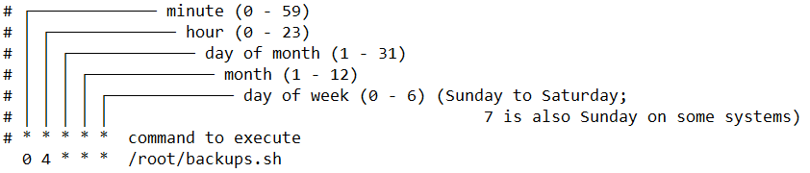
Crontab Editing
crontab -e – Edit your crontab entry with your default editor
  Your default editor is vi
  Change your default editor to nano with the following command:
    export EDITOR=nano
    This is not persistent! Add that command to your ~/.bashrc file to make permanent!
The crontab file is a space separated list of scheduled commands
  Commands are scheduled by minute, hour, day of month, month, and day of week
System crontab files - /etc/cron*
  Can be set to run as a user

Slide 20

Secure Copy - Rsync
Rsync - Remote Synchronize
  Used to keep files in in sync between hosts
  Can use SSH for encrypted communications
    Some systems use SSH as default for rsync, some don’t
    Force ssh with -e “ssh”
  Supports multiple options
    -a : Archive mode - Copy recursively, preserve links/permissions/ownership/timestamps
    -v : Verbose - Show what files are being copied and where
    -z : Compression - Compress data being transferred
    -h : Human-readable - Display numbers in human-readable format
    --delete: Delete – Delete files in the target that don’t exist in the source
    Many more options available! Check the man pages!
  Ex:
    rsync options source destination
    rsync -avzh /data/Blockland/ 10.11.186.146:/opt/Blockland/
    rsync -avh --delete /root /backups/
    rsync -avh --delete /var/log/ /backups/var/log/
Make note of your trailing slashes / !!!

Slide 21

MySQL Dump
mysqldump - Create an output file containing all the data within a database
  -a, --create-options Include all specific create options in CREATE statements.
  -A, --all-databases Dump all the databases.
  -p[passwd] The password to use when connecting to the server. Omit the password to be prompted.
    Entering your password on the command line is bad practice!
  -u name The MariaDB user name to use when connecting to the server.
Examples:
  mysqldump -u root -p --create-options --databases temperature > /tmp/temperature.sql
    Dump the data from the temperature database to the file /tmp/temperature.sql, creating the database if necessary.
  mysqldump -u root -p -a --databases wordpressdb > /backups/mysql/wordpressdb.sql
    Dump the wordpressdb database to the wordpressdb.sql file, with create options.
  mysqldump -u root -p --create-options -A > /tmp/databases.sql
    Dump all databases to the /tmp/databases.sql file, creating the databases if necessary.

Slide 22
MySQL Performance Tuning
innodb_buffer_pool_size
  InnoDB maintains a storage area called the buffer pool for caching data and indexes in memory.
key_buffer_size
  A cache mechanism used to keep the most frequently accessed table blocks in memory, minimizing disk I/O.
innodb_log_file_size
  A log file of transactions, used to replay data entries after a system crash. Larger values mean less disk I/O due to less flushing checkpoint activity, but also slower recovery from a crash.
Basic recommendations (may differ depending on exact platform configuration!)
  innodb_buffer_pool_size: Roughly 80% of system RAM
  key_buffer_size: 32M for 1GB RAM, 96M for 2GB RAM, 256M for 4GB RAM and 768M for 8GB RAM
  innodb_log_file_size: 64-128M
Percona Tools (https://tools.percona.com) can create a custom configuration (account required, free)
Notes:
Many additional tools available for database tuning!

Slide 23
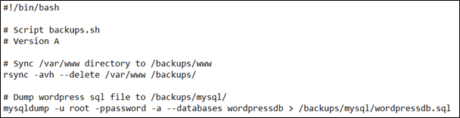
Create Backups
Make Backup Directories
  mkdir -p /backups/mysql
Install rsync!
  dnf -y install rsync
Synchronize specific directories
  rsync -avh --delete /var/www /backups/
Use mysqldump to create a backup of your WordPress database
  mysqldump -u root -p -a --databases wordpressdb > /backups/mysql/wordpressdb.sql
You can optionally put these commands into a script, and call the script with cron
  Script: (somewhere like /root/backups.sh)
If you enter your password
at a bash prompt, it will
be visible in your history!

Slide 24
Modify settings for performance
Create your own mysql configuration file
  New File: /etc/my.cnf.d/custom.cnf
      [mysqld]
      key-buffer-size = 256M
      innodb-buffer-pool-size = 2048M
      innodb-log-file-size = 128M
  Stop MariaDB and flush the innodb log files
    systemctl stop mariadb
      mv /var/lib/mysql/ib_logfile[0-1] /tmp/
      systemctl start mariadb
  Optionally, you can configure additional settings as required by your workload
    Various memory and system optimizations can be configured in /etc/systemctl.conf
    Per-user/per-group/system resource limits configured in /etc/security/limits.conf
Create specific DB settings with tools.Percona.com!

Slide 25
Network File Systems (NFS) Client Install
Mapping a NFS share to a local mount point
  Install NFS Client tools (should already be installed)
    dnf -y install nfs-utils
  Create the local folder to mount at:
    mkdir /share
  Add network mount to filesystem configuration file /etc/fstab
    147.64.243.110:/share /share nfs bg,rw,sync,hard,intr 0 0
  Mount any missing filesystems from /etc/fstab file
    systemctl daemon-reload; mount -a
  Check that filesystem has been mounted
    df -h /share
      147.64.243.110:/share 16G 1.8G 14G 12% /share
  Manually unmount and remount network file system
    umount /share
    mount 147.64.243.110:/share /share

Slide 26
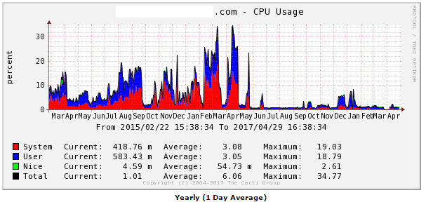
Monitoring Operating Systems
Splunk
  Log file aggregation tool - Organize many different log files into a single searchable interface
    Multiple logs from multiple systems!
  Correlate information between different logs/systems/etc.
Cacti
  Monitor network, CPU, disk space, etc.
  Long-term system monitoring
  Example graph to right →
Naigos
  Similar to Cacti
  Monitor system resources
Netdata
  Real-time short-term system monitoring
Nimbus

Slide 27
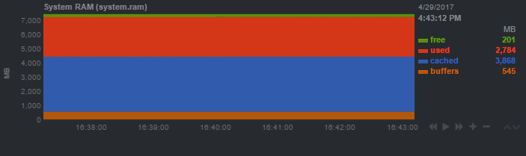
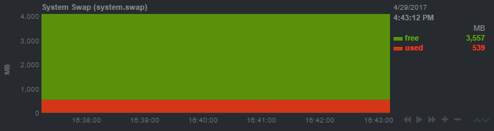
Monitoring Memory
RAM - Physical Memory
Swap - Items in RAM stored on disk
free command - Show how much
RAM is being used
Images shown are from Netdata
  Netdata is free and easy to install!
  Netdata only displays recent data…
Lets flush some cache and
drop the swap!

Slide 28
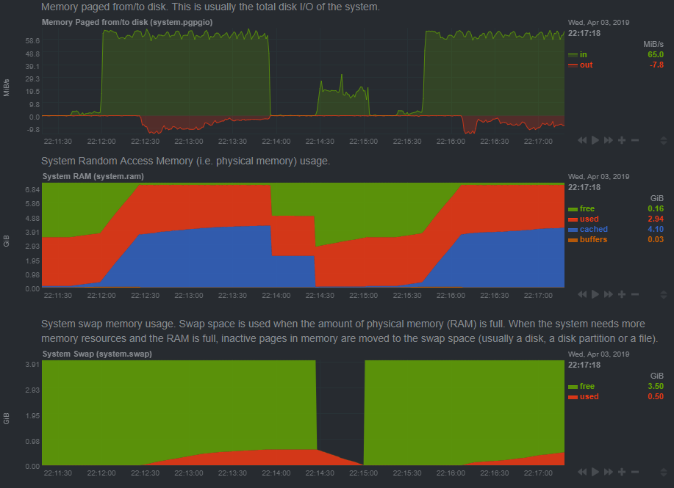
Monitoring Memory
Flush out all RAM buffers
  Orange in middle graph
  Minimal usage
Flush out all RAM cache
  Blue in middle graph
Move all swap to active RAM
  Move red from lower to middle
See true memory usage!
  Cache and buffers should
  be taken into account!
Notes:
free
python3 -c 'a="a"*1024**3*16; input()' #force 16GB to swap
cat /data/upload/Win11_24H2_English_x64.iso > /dev/null #force file to cache ram
free
sync
swapoff -a
echo 3 > /proc/sys/vm/drop_caches
swapon -a
free

Slide 29
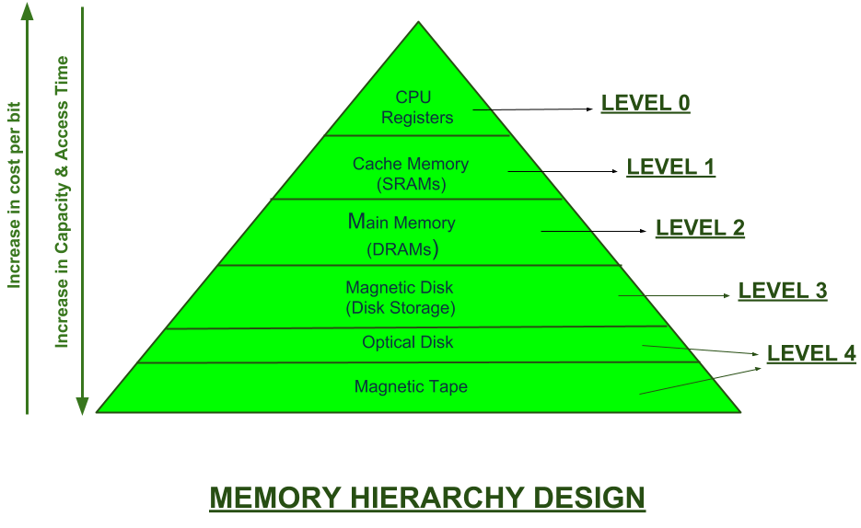
Monitoring Memory
RAM - Physical Memory (Level 2 in image)
Swap - Items in RAM stored on disk (Level 3 in image)
New m2 Disks support level 3 storage at level 2 speeds!
  Replacement for mSATA & mini-PCI
  New CPU’s have native support!
  NVMe – Non-Volatile Memory Express
  Increased interface speed – 32Gbps?!
  Multiple different speeds/types/shapes/sizes
    Keying!

Slide 30
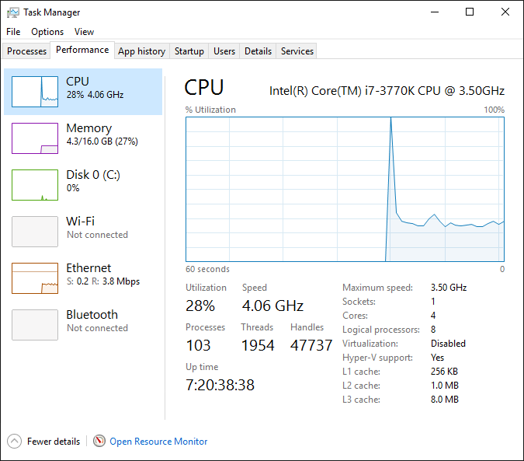
Monitoring Windows
Performance monitoring allows you to compare system performance over time
  You can set multiple counters and watch them in real-time
Windows Task Manager highlights CPU and memory usage
You can modify services to notify you if a service fails

Slide 31

Monitoring Linux
Log File Analysis
  Linux logs are located in /var/log directory
  Sub directories for specific applications (/var/log/httpd or /var/log/mariadb)
  Main Linux log file is /var/log/messages
  Use the tail or cat commands to easily read the log files
    Ex: tail -n 100 /var/log/messages
Logs are used to detect or discover any problems or potential issues
  OS Logs
  Application Logs
  Security Logs
Various tools can monitor performance
  Splunk, Naigos, Cacti, Nimbus
Compare security with standard baseline information

Slide 32
Monitoring Linux
Logging is controlled by rsyslogd daemon
  systemctl status rsyslog
Facility indicates where the message came from (kernel, mail, etc.)
Facility | Description
authpriv | User authorization
cron | Crontab system messages (scheduled tasks)
daemon | Daemon messages (services)
kern | Kernel (core OS) messages
local0-local7 | Various system use; boot or Apache messages
lpr | Printer subsystem messages
mail | E-Mail server messages

Slide 33
Monitoring Linux
Message priority levels
Priority | Description
emerg | Emergency messages about the system - system failure!
alert | Alert messages which require immediate action
crit | Critical messages, indicating a subsystem (mail) is not working
err | General error messages; partial subsystem functionality may not be working
warning | Warning messages, typically application configuration errors
notice | Important messages that are not errors
info | General information messages
debug | Detailed application debugging logs. Generally only use when debugging!

Slide 34

Monitoring Apache
Apache logs by default will be located at /var/log/httpd
  Error logs: /var/log/httpd/error_log
  Access logs: /var/log/httpd/access_log
Custom log locations can be configured within individual VirtualHost definitions
  Ex:
Example!
<VirtualHost *:80>
DocumentRoot "/var/www/web"
# Note server name below is 2 digits
ServerName 25.megastuff.biz
ErrorLog /var/log/httpd/web_error_log
CustomLog /var/log/httpd/web_access_log combined
<Directory /var/www/web>
Order Deny,Allow
Deny from all
allow from localhost 147.64.0.0/16 10.0.0.0/8
</Directory>
</VirtualHost>

Slide 35
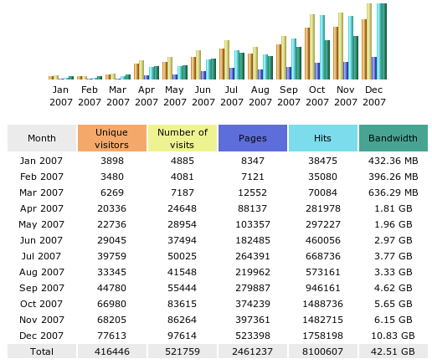
Web Server Analysis Tools
Analysis tools extract system data from log files and identify potential issues
Can be used to create usage graphs
Web-based tools
Webalizer
AWStats

Slide 36
AWStats Installation
Install AWStats
  dnf –y install awstats
Edit AWStats Apache config file, allow any IP to connect
  File: /etc/httpd/conf.d/awstats.conf
Require local → Require all granted
Allow from local IP’s → Allow from any
<Directory "/usr/share/awstats/wwwroot">
Options None
AllowOverride None
<IfModule mod_authz_core.c>
# Apache 2.4
Require all granted
</IfModule>
<IfModule !mod_authz_core.c>
# Apache 2.2
Order allow,deny
Allow from any
</IfModule>
</Directory>

Slide 37
AWStats Installation
Restart Apache
  systemctl restart httpd.service
Visit webpage
  http://ecsc325-1##.cs.edinboro.edu/awstats/awstats.pl?config=localhost.localdomain
Visit your webpages a few times
  ##.megastuff.biz, 1##.megastuff.biz, 31##.megastuff.biz, etc…
Update statistics
  Run command:
    /usr/share/awstats/wwwroot/cgi-bin/awstats.pl -config=localhost.localdomain -update
Refresh earlier webpage after updating statistics!
  http://ecsc325-1##.cs.edinboro.edu/awstats/awstats.pl?config=localhost.localdomain

Slide 38
AWStats Installation
Configure automatic statistic updates
  Create a new crontab entry for root user:
    */5 * * * * /usr/share/awstats/wwwroot/cgi-bin/awstats.pl -config=localhost.localdomain -update
      This runs the command every 5 minutes as the root user
      https://en.wikipedia.org/wiki/Cron#Overview
Creating crontab entry:
  Command crontab -e opens crontab editor
  Crontab editor opens using default editor - may be vi!
  Change default editor to nano with following command:
    export EDITOR="nano"
    Only persists while logged in!
    Add the export command to the end of your ~/.bashrc file to make permanent
      Must be set per user!

Slide 39

IPTables Examples - WWW
Allow any TCP packets coming in on port 80
  iptables -A INPUT -p tcp --dport 80 -j ACCEPT
Restrict TCP traffic coming in on port 80 to unprivileged source ports
  iptables -A INPUT -p tcp --dport 80 --sport 1024:65535 -j ACCEPT
Restrict inbound port 80 TCP traffic to specific IP and network interface
  iptables -A INPUT -i eth0 -p tcp -d 192.168.1.10 --sport 1024:65535 --dport 80 -j ACCEPT
Allow outbound traffic to TCP port 80 from our server
  iptables -A OUTPUT -p tcp --dport 80 -j ACCEPT
Allow outbound traffic to UDP port 443 from our server
  iptables -A OUTPUT -p udp --dport 443 -j ACCEPT
Example!
We’re not using iptables commands!

Slide 40
IPTables Examples - SSH
SSH uses port TCP 22
Input rules for SSH Servers:
  iptables -A INPUT -p tcp --dport 22 -j ACCEPT
Output rules for SSH Connections:
  iptables -A OUTPUT -p tcp --dport 22 -j ACCEPT
Rules can potentially be more complex/restrictive
  iptables -A OUTPUT -o eth0 -p tcp -s 192.168.0.1 --dport 22 --sport 1024:65535 -j ACCEPT
    Only allow traffic from 192.168.0.1
    Only accept on interface eth0
    Only accept to destination port 22
    Only accept from source port range 1024-65535
Example!
We’re not using iptables commands!

Slide 41
Firewall Configuration Examples
FirewallD
  Front-end controller for iptables, used to implement persistent network traffic rules
  Command line and graphical interfaces available
  Rules can be added/removed/modified without interfering with current network traffic
  firewall-cmd command used to modify firewall rules
    firewall-cmd --get-default-zone
      What zone is currently being used by default
      Different zones can be applied to different interfaces
    firewall-cmd --get-active-zones
      What zones are currently active on what interfaces
    firewall-cmd --zone=public --list-all
      What rules are currently configured in the firewall
Example!

Slide 42
Firewall Configuration Examples
FirewallD
  Front-end controller for iptables, used to implement persistent network traffic rules
  Command line and graphical interfaces available
  firewall-cmd command used to modify firewall rules
    firewall-cmd --zone=public --add-service=http
      Allow http traffic to the runtime configuration
    firewall-cmd --zone=public --add-service=http --permanent
      Allow http traffic to the permanent configuration
    firewall-cmd --zone=public --add-port=8080/tcp
    firewall-cmd --zone=public --add-port=8080/tcp --permanent
      Allow traffic to TCP port 8080 from any host, runtime and permanent configs
  Rich Rules can be created for more advanced traffic control
    firewall-cmd --zone=public --add-rich-rule 'rule family="ipv4" source address="192.168.0.0/24" port port=12345 protocol=udp accept' --permanent
      The above command is all one line…
Example!

Slide 43

Assignment 11 Checklist
AWStats should be installed and have:
  Config file at /etc/httpd/conf.d/awstats.conf
  Crontab entry for root user
  Respond to webpage queries
Read assignment 11 and run assignment 11 check script
  http://jpatalon.cs.edinboro.edu/ecsc325/Assignment%2011.pdf
  http://jpatalon.cs.edinboro.edu/ecsc325/classfiles/assignment11check.sh
  Don’t forget to set script executable before running!
  Documentation!
Parts of this assignment - 45 Points
  AWStats configs
  Backups of web files and WordPress database
  MariaDB configuration optimization updates
  System updates and reboot!

Slide 44
Virtual Hosts
http://ecsc325-1##.cs.edinboro.edu, http://147.64.243.1##
  PHP Info
http://ecsc325-1##.cs.edinboro.edu/phpmyadmin, http://147.64.243.1##/phpmyadmin
  phyMyAdmin Website
http://1##.megastuff.biz/temp/temp.php
  Temperature Graph Website
http://31##.megastuff.biz
  index.html: Hello Megastuff Website
http://##.megastuff.biz
  TBD: Testing 123…
http://1##.megastuff.biz
  TBD: Testing 123…
http://ecsc325-1##.cs.Edinboro.edu/squirrelmail
  Squirrelmail website
http://roundcube.##.megastuff.biz
  Roundcube webmail
http://1##.ultrastuff.net
  Ultra Modern Template Website
http://31##.ultrastuff.net
  WordPress Website
https://ecsc325-1##.cs.edinboro.edu/private
  Private web site!
https://a13.##.megastuff.biz
  Assignment 13 web site!
Replace the ## with your 2 digit number!!!

Slide 45
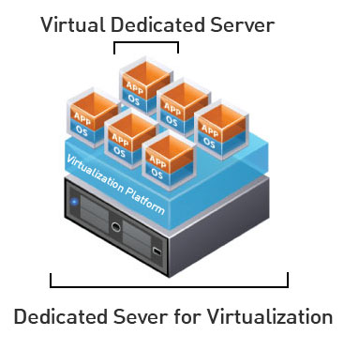
Virtual Machine Info
IP Address: 147.64.243.1##/23 (01-25)
Hostname: ecsc325-1##.cs.edinboro.edu (01-25)
Aliases:
  31##.megastuff.biz, 1##.megastuff.biz, ##.megastuff.biz (01-25)
  1##.ultrastuff.net, more?
Assignment 9 due March 19th
  Check script and upload in D2L!
Accessing VM’s from off campus requires a connection to the CS VPN first,
before opening a connection to your machine!
  CS firewall prevents direct connections from other networks to our VM’s!
    Once VPN is active: ssh user@ecsc325-1##.cs.edinboro.edu

Slide 46

Linux Commands
dig
nslookup
ftp
scp
rsync
umask
yum
systemctl
chown
chmod
mysqldump
ssh
mkdir
wget
cd
echo
mv
pwd
vi
nano
mysql
rm
rpm
FTP commands
  get
  put
  cd
  lcd
  pwd
  !pwd
  open
  close
  quit

Slide 47

Key Terms and Items
Data Centers
Power Distribution Units
Cron/Crontab
RSync

Slide 48

For Next Class
Go confidently in the direction of your dreams. Live the life you have imagined.
  Henry David Thoreau
Textbook:
  Chapter 20: POP & IMAP
Upcoming topics
  Security & Authentication
  Clouds
Finish work with VM’s
  Assignment 9 due this week!
  Assignment 10 due next week!
  Just because all tests say OK, doesn’t mean everything is working properly!
    I can’t write check scripts for every possibility…

Slide 49
ECSC 325.200
Web Server Administration
Spring 2025 – Week 10-2 – March 20th, 2025
Monitoring, Logging, Firewalling, Virtualizing, Cloud
Prof. Jason Patalon

Slide 50

Objectives
Monitoring Apache
Firewall Examples
Virtualization
Intro to Cloud
Amazon Web Services
Notes:
Easy may be relative…

Slide 51
Recap and Review
The next few weeks…
  Security and Authentication
  Firewalls and Filters
  Network Services
  Cloud
  Final Exam!
Corrections, updates, etc.
Questions from previous classes?
  Feel free to ask during class, after class, email, office hours…
Etcetera

Slide 52
Firewall Configuration Examples
FirewallD
  Front-end controller for iptables, used to implement persistent network traffic rules
  Command line and graphical interfaces available
  Rules can be added/removed/modified without interfering with current network traffic
  firewall-cmd command used to modify firewall rules
    firewall-cmd --get-default-zone
      What zone is currently being used by default
      Different zones can be applied to different interfaces
    firewall-cmd --get-active-zones
      What zones are currently active on what interfaces
    firewall-cmd --zone=public --list-all
      What rules are currently configured in the firewall

Slide 53
Firewall Configuration Examples
FirewallD
  Front-end controller for iptables, used to implement persistent network traffic rules
  Command line and graphical interfaces available
  firewall-cmd command used to modify firewall rules
    firewall-cmd --zone=public --add-service=http
      Allow http traffic to the runtime configuration
    firewall-cmd --zone=public --add-service=http --permanent
      Allow http traffic to the permanent configuration
    firewall-cmd --zone=public --add-port=8080/tcp
    firewall-cmd --zone=public --add-port=8080/tcp --permanent
      Allow traffic to TCP port 8080 from any host, runtime and permanent configs
  Rich Rules can be created for more advanced traffic control
    firewall-cmd --zone=public --add-rich-rule 'rule family="ipv4" source address="192.168.0.0/24" port port=12345 protocol=udp accept' --permanent
      The above command is all one line…

Slide 54
Data-Center Infrastructure
Storage
  Physical Disk Storage
    Local server storage
    Storage Area Network (SAN)
    Network Attached Storage (NAS)
Networking
  Three-Tier Design
    Core Switches
    Aggregation or Distribution Switches
    Access or Top of Rack Switches (multiple layers)
Compute
  Various form factors
    Rack mount, blades, desktop chassis
  RAM/CPU/Motherboard – Sometimes storage

Slide 55
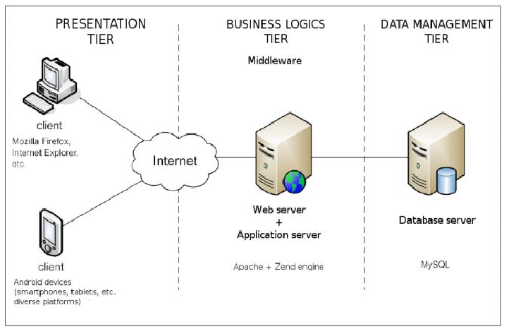
3-Tier Architecture
A Client-Server software architecture pattern
Clients interact with the presentation tier
  Also called the client tier
  Web browser, mobile device interface, or others (fat client)
Logic Tier coordinates the application and commands
  Programming and website logic
  Website server
Data tier stores and organizes data
  Databases
  SQL commands and similar
Middleware may be in place connecting between layers

Slide 56

Hyper-Converged Infrastructure
Virtualizes the aspects of a conventional hardware defined data center system
  Virtualized computing (VM’s), Virtual SAN, Virtual Networking
  Often times run on commodity (off the shelf) hardware
    Decreased costs, can be easier to obtain, can be a lesser quality…
  Software defined IT Infrastructure
    Virtualize everything, script everything, automate everything
    Easily repeatable, easily auditable, easily maintained
  How far can you virtualize?
  How much can you automate?
  Leads to different data center methodology!
    Standardize hardware components
    Virtualize everything
    Script the entire deployment of your infrastructure
      Then automate your middleware and app deployments!

Slide 57
Apache Cassandra
A free and open source NoSQL database management system
Designed to handle large amounts of data across many commodity pieces of hardware
Designed for high availability without any single points of failure
Supports clusters across data centers
Asynchronous master replication with low latency
Distributed
Supports replication
Much more!

Slide 58
Cloud Computing
The on-demand availability of computer system resources, with a level of abstraction from direct user interaction
  Depending on the cloud service, you may have different levels of access
  The provider can offer services at multiple levels
  Geographically different locations for availability
    Eastern US, Western US, Europe, Asia, etc.
  Typically a pay per use model
    $0.10/hour ≈ $70/month
  Amazon started AWS in 2006
    Others followed, such as Google, Microsoft, and others
  Allows users to leverage a large, resilient, fault tolerant
  infrastructure platform with minimal knowledge of the
  underlying hardware and software technologies

Slide 59
Cloud Computing
Several key characteristics identify cloud computing:
  Agility to move and adjust
  Lower cost/barrier to entry
  Reduction of maintenance and overhead costs
  Reliability and scalability
  Enhanced security
  Advanced monitoring, logging, and statistics
Cloud computing can be on or off-premises
  On-prem: A cloud-like environment in your data center
  Off-prem: A cloud-like environment on the internet
Flexibility is key!
Someone else’s datacenter!

Slide 60

Anything as a Service (XaaS)
Infrastructure as a Service – The vendor manages the infrastructure, providing you with a Guest OS that you can manage
  This is what we have on campus – EUP manages all networking, storage, and hardware
  Co-Location – A type of IaaS where you provide the server hardware in their environment
  Typically identified by having full admin/root access to the VM
  Linode, Rackspace, DigitalOcean, Hurricane Electric, AWS, Azure
Platform as a Service – Provides standard software components, providing you a
platform to run your application, store your database, or save your documents.
  The platform handles capacity provisioning, monitoring, package and
  dependency installation, etc.
  You only need to deploy code that fits the stack
  AWS Elastic Beanstalk, Apache Stratos, OpenShift
Software as a Service – The vendor manages everything, you only use the software!
  Google docs, Office 365, Dropbox, Webex

Slide 61
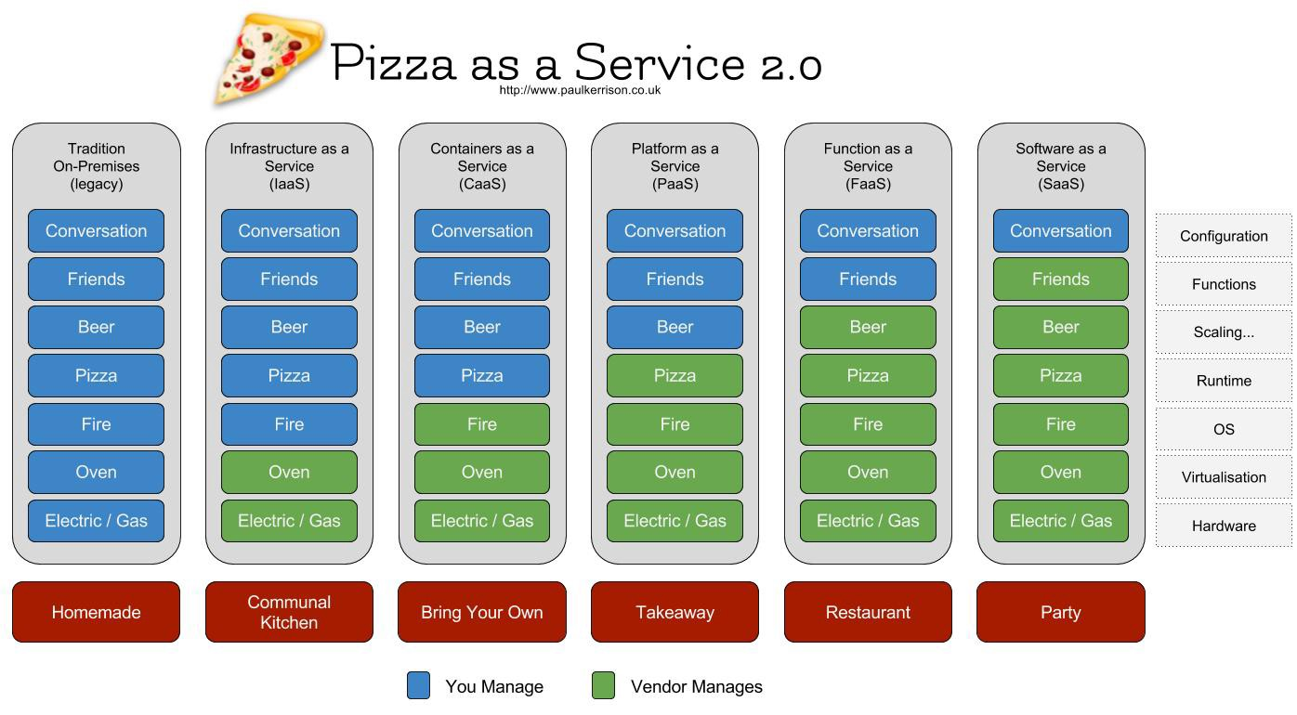

Slide 62
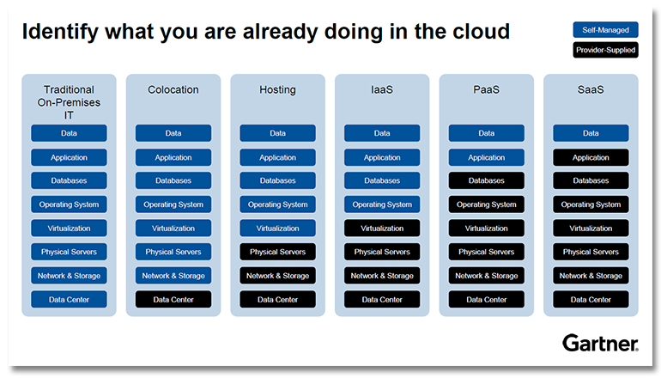

Slide 63

Intro to Amazon Web Services
Started with S3 (Simple Storage services), expanded to multiple other services
Compute – Various different operating system
  Create your own custom OS images to deploy from
  Virtual Machines!
  Auto Scaling Groups
  Load Balancers
Storage – Multiple types of data storage
  SSD or traditional disks for block storage
  Object storage for video/image files, etc
Database – Relational databases or others (NoSQL)
  Create your own databases or database management systems
  Backups, availability, etc.

Slide 64
Intro to Amazon Web Services
Networking – Create your own logically separate network
  Virtual Private Cloud (VPC) – Separate routes, CIDR masks, subnets, and more
    Encrypted connections possible as a service
  Route 53 – Cloud DNS Management
Many more services!
  Email, messaging, analytics, data analysis, security, utilization, deployment services, mobile services…
Multiple ways to manage your services
  AWS Management GUI Console
  AWS Command Line Interface
  AWS API HTTP Calls
  Various SDK’s for multiple programming languages
  IDE toolkits for Eclipse and Visual Studio

Slide 65
Intro to Amazon Web Services
AWS Regions
  Fairly independent collections of data centers
  within a specific geographic area
    US East, N Virginia, us-east-1
    US West, Oregon, us-west-2
    Asia Pacific, Tokyo, ap-northeast-1
  https://www.cloudping.info/
Availability Zones
  A specific zone within an AWS Region
  Separate datacenters
  Low latency connections between AZ’s
  Provides for fault-tolerant designs
    If an AZ goes offline, you can run on another AZ in that region
Geolocation!

Slide 66
Intro to Amazon Web Services
Benefits and use cases for AWS services
  Faster time to deployment of new applications
  Cloud backup and storage archival options
  Disaster recovery strategies with AWS
    Cold, warm, and hot sites
  Edge locations
    Content delivery networks
    Keep the data cached closer to the end user
  Computationally intense tasks
    You’re only charged while your task runs – typically per hour
      Rate changes depending on what the type/speed/config of VM
    100 Hours on 10 VM’s = 1 hour on 1,000 VM’s
    Save money, especially if tasks are infrequent

Slide 67
Virtual Machine Info
IP Address: 147.64.243.1##/23 (01-25)
Hostname: ecsc325-1##.cs.edinboro.edu (01-25)
Aliases:
  31##.megastuff.biz, 1##.megastuff.biz, ##.megastuff.biz (01-25)
  1##.ultrastuff.net, more?
Assignment 9 due March 19th
  Check script and upload in D2L!
Assignment 10 due March 26th
  Check script and upload in D2L!
Accessing VM’s from off campus requires a connection to the CS VPN first,
before opening a connection to your machine!
  CS firewall prevents direct connections from other networks to our VM’s!
    Once VPN is active: ssh user@ecsc325-1##.cs.edinboro.edu

Slide 68
Virtual Hosts
http://ecsc325-1##.cs.edinboro.edu, http://147.64.243.1##
  PHP Info
http://ecsc325-1##.cs.edinboro.edu/phpmyadmin, http://147.64.243.1##/phpmyadmin
  phyMyAdmin Website
http://1##.megastuff.biz/temp/temp.php
  Temperature Graph Website
http://31##.megastuff.biz
  index.html: Hello Megastuff Website
http://##.megastuff.biz, http://1##.megastuff.biz
  TBD: Testing 123…
http://ecsc325-110.cs.edinboro.edu/awstats/
awstats.pl?config=localhost.localdomain
  AWStats
http://ecsc325-1##.cs.Edinboro.edu/squirrelmail
  Squirrelmail website
http://roundcube.##.megastuff.biz
  Roundcube webmail
http://1##.ultrastuff.net
  Ultra Modern Template Website
http://31##.ultrastuff.net
  WordPress Website
https://ecsc325-1##.cs.edinboro.edu/private
  Private web site!
https://a13.##.megastuff.biz
  Assignment 13 web site!
Replace the ## with your 2 digit number!!!

Slide 69
Linux Commands
dig
nslookup
ftp
scp
rsync
umask
dnf
systemctl
mysqldump
iptables
firewall-cmd
ssh
mkdir
wget
cd
echo
mv
pwd
vi
nano
mysql
rm
rpm
FTP commands
  get
  put
  cd
  lcd
  pwd
  !pwd
  open
  close
  quit

Slide 70
Key Terms and Items
MTA / MSA / MDA / MUA
Open E-Mail Relay
Masquerading
MX Records
SMTP
POP3
IMAP4
Spamblocking
FTP
All In One Network Routers
Firewalls & firewalld
SSH / Reverse SSH / Proxy
AWStats
Pull-based & Push-based transfers
Active vs. Passive FTP Transfers
FTPS vs. SFTP
Implicit vs. Explicit encription
SCP
Rsync
Server Message Block (SMB)
Common Internet File System (CIFS)
DFS
Umask
VSFTPd
Syslog/rsyslog
Apache Logging

Slide 71
For Next Class
“Rivers get connected so much stronger than expected...” –Red Hot Chili Peppers
Textbook:
  Chapter 13: Netfilter Firewall
  Chapter 14: Local Security
Continuing work with VM’s
  Just because all tests say OK, doesn’t mean everything is working properly!
    Sometimes my check scripts have errors…
    I don’t always check for every possible entry…

